Slide 1
Ultra document search
- In Short UDS
SAIKUMAR V (N110789) Role : Developer & Backend
RAJESH P (N110046) Role : Designing & Frontend
ANAND P (N110078) Role : Documentation & Research
Project Guide: Mr. Bhuvan Allu Sir, IT Mentor

Slide 2
Contents
Introduction
Description
User Interaction with application
About UDS
Technologies used
Benefits
Further Implementation

Slide 3
Introduction
Till now we have applications to search required documents in a bulk of folders.
They can only deal with the names of documents
This Application can search the documents in a bulk of folders for which contains the required word or sentence.
It can deal with the content inside document

Slide 4
Description
UDS is a java application which can show file names as well as number of times that word is present
UDS works faster. It uses the KMP pattern search algorithm.

Slide 5
User Interaction
Target Directory
Lateral Search
Deep Search
Search Function
Result Panel
Advanced Option panel

Slide 6
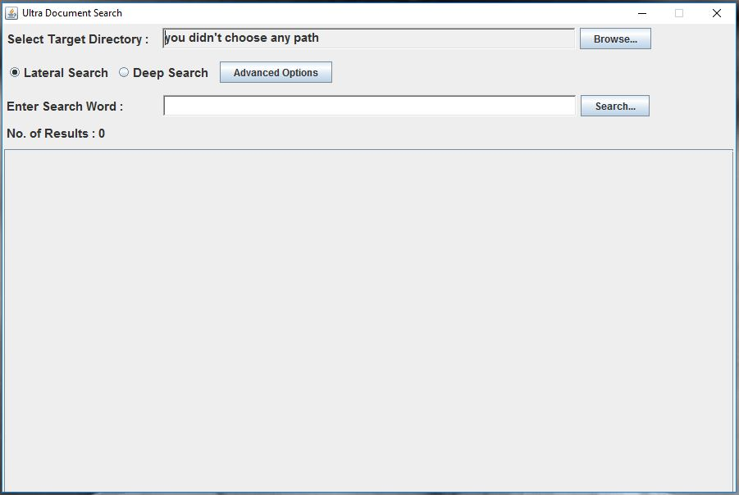
User Interaction

Slide 7
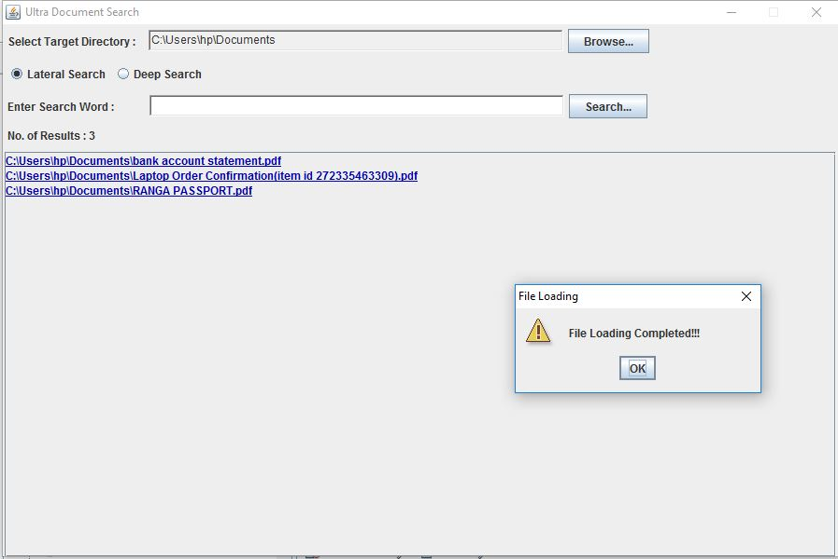

Slide 8
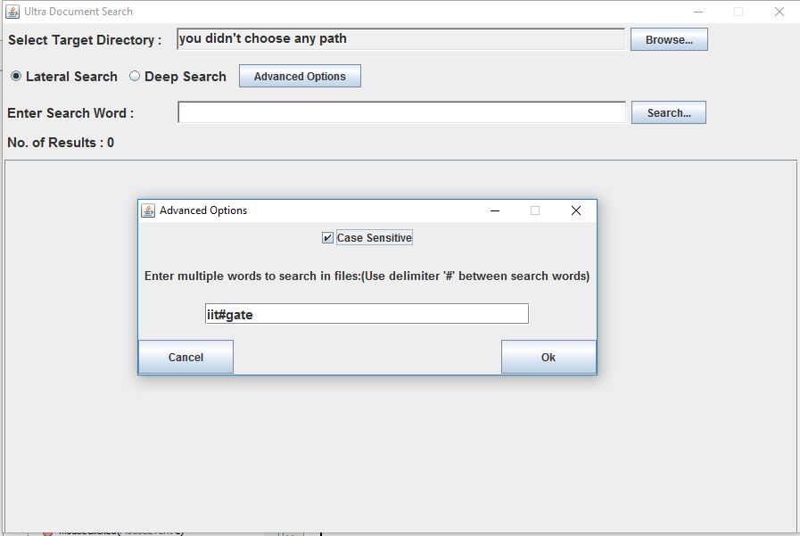

Slide 9
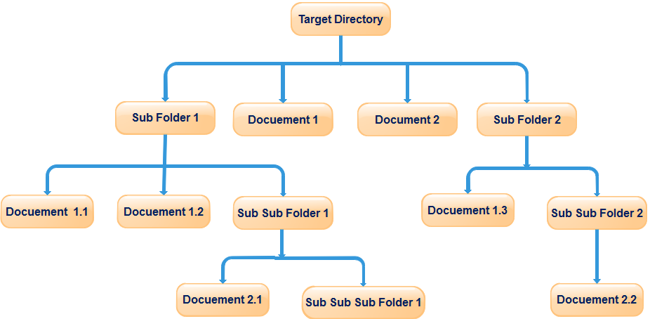
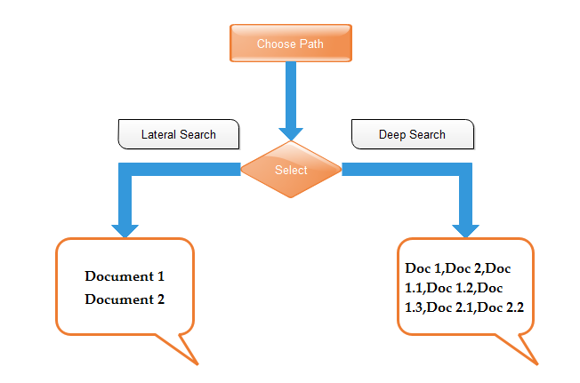
About Ultra Document Search

Slide 10
Technologies Used
Programming Language:
Java Technologies
PDFBox API from Apache Foundation
Algorithm:
KMP pattern Algorithm for Searching

Slide 11
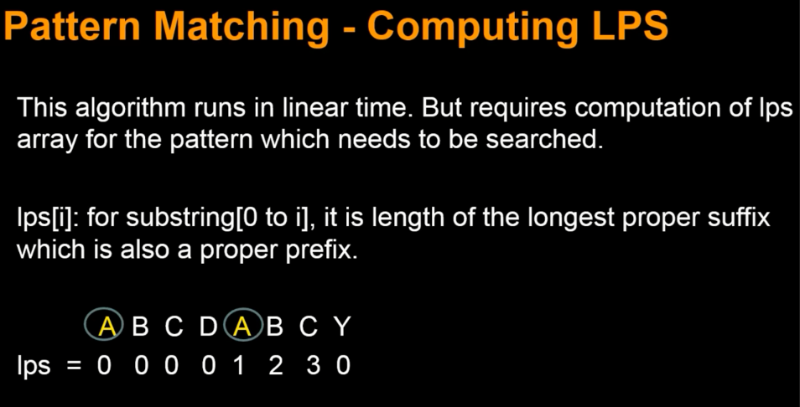
Knuth-Morris-Pratt (KMP) Algorithm

Slide 12






Slide 13






Slide 14
Benefits of Application
Don’t need to open every file and perform search
Easy to find a topic
Platform independent
You can even search the word in the document with case sensitive
You can search the documents with multiple words.

Slide 15
Further Implementation
Devolving a windows application using Visual Basic .NET (VB .NET)
Add extra features to make it user friendly. Ex: sort by feature
To work with many types of files(extensions).
To perform search on remote system by using networking.

Slide 16
Thank You

